Slide 1
Information Technology Fundamentals
DT228/1
Tutorial 7 – Managing Complexity
Thursday 17 November 2016

Slide 2
Managing Complexity
Through project management
EG Gantt Charts, Critical Path Analysis...
Through hardware/networking development tools
EG MontaVista, Ethernet development tools... (There are MANY of these – see next slide.)
Through software development tools
EG Integrated Development Environment (IDE), GitHub...

Slide 3
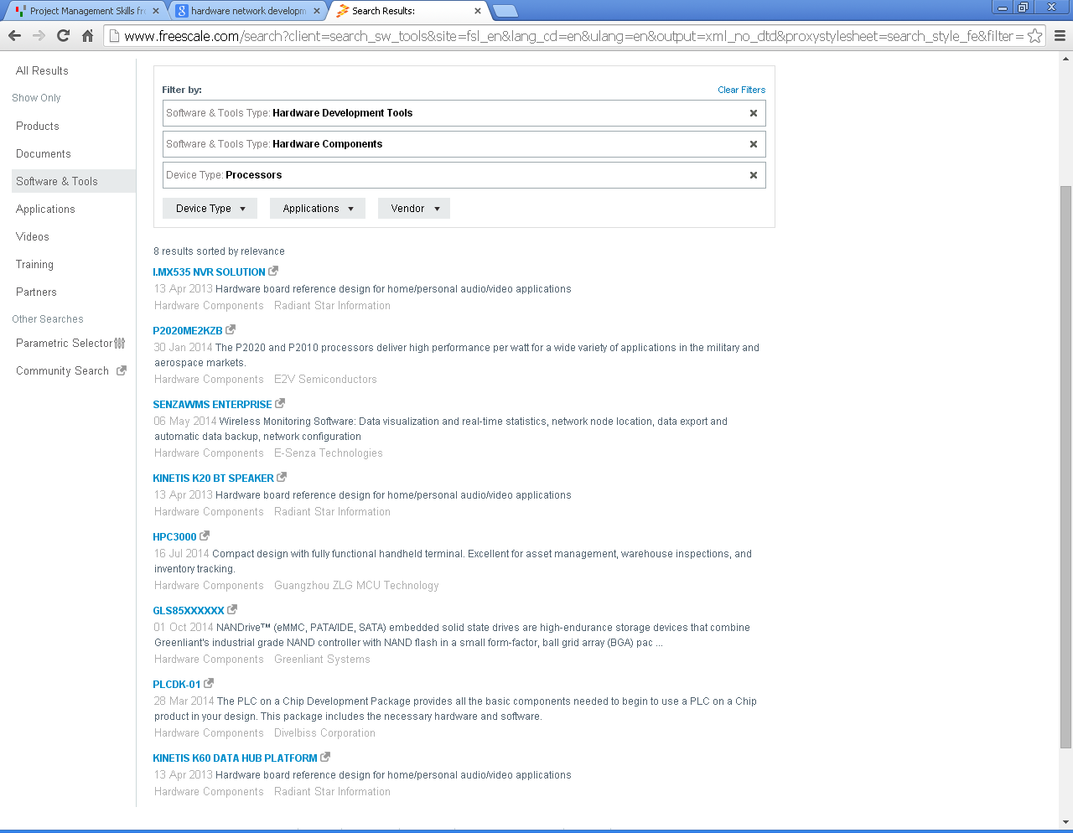

Slide 4
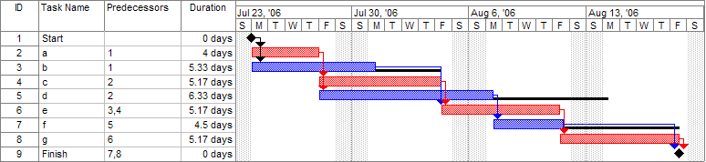
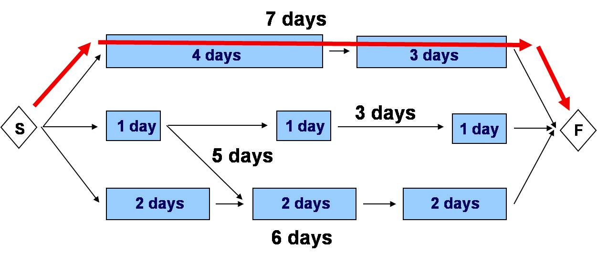
Gantt Charts, Critical Path Analysis
A Gantt Chart
A Critical
Path

Slide 5
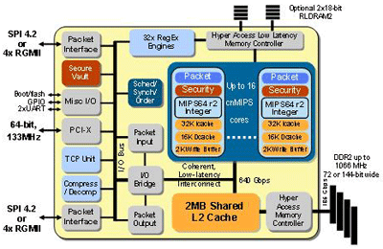
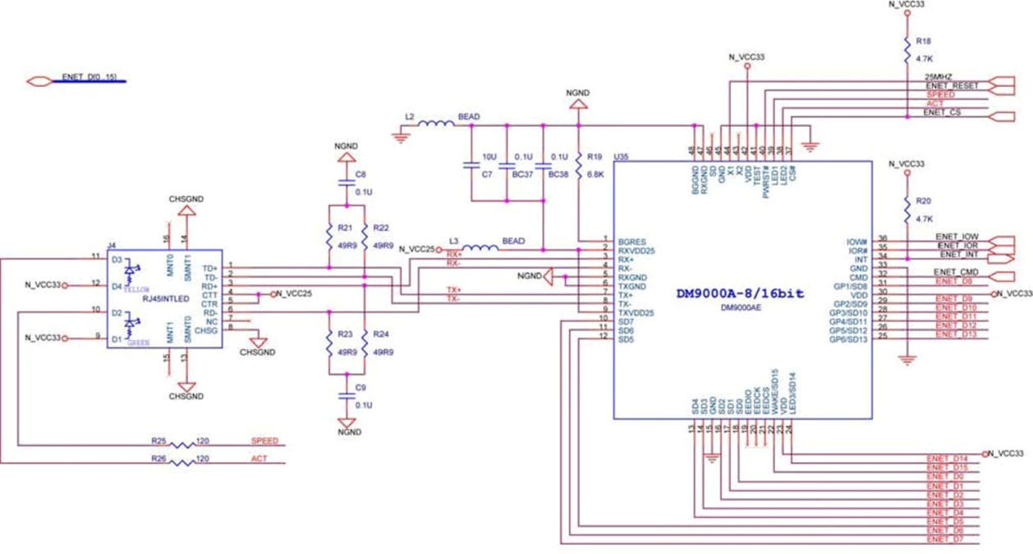
MontaVista, Ethernet Development Tools
This diagram can be related to MontaVista
Ethernet Network Controller

Slide 6
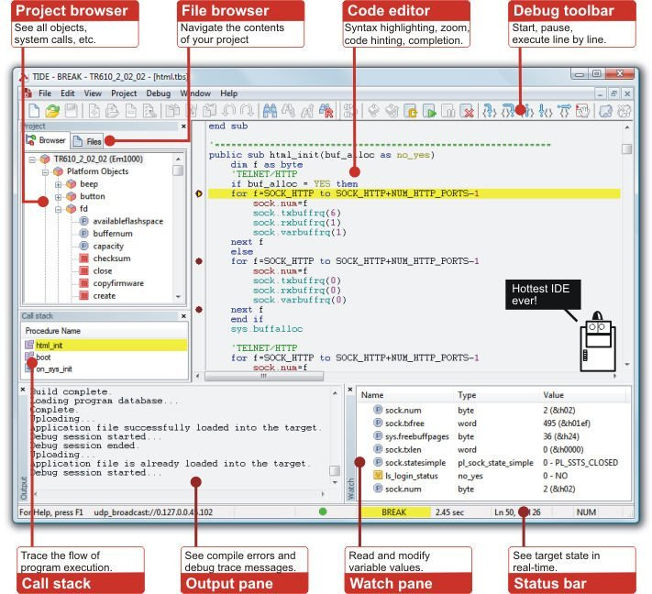
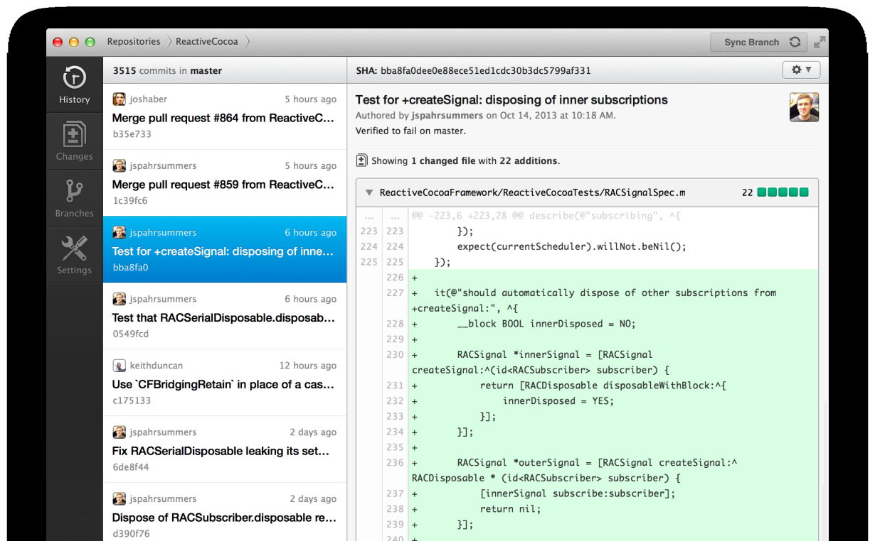
IDE, GitHub
A GitHub Page
IDE Integrated Development Environment

